Slide 1
The Pigeonhole Principle
Brendan Ascorra
Discrete Mathematics CS 131

Slide 2
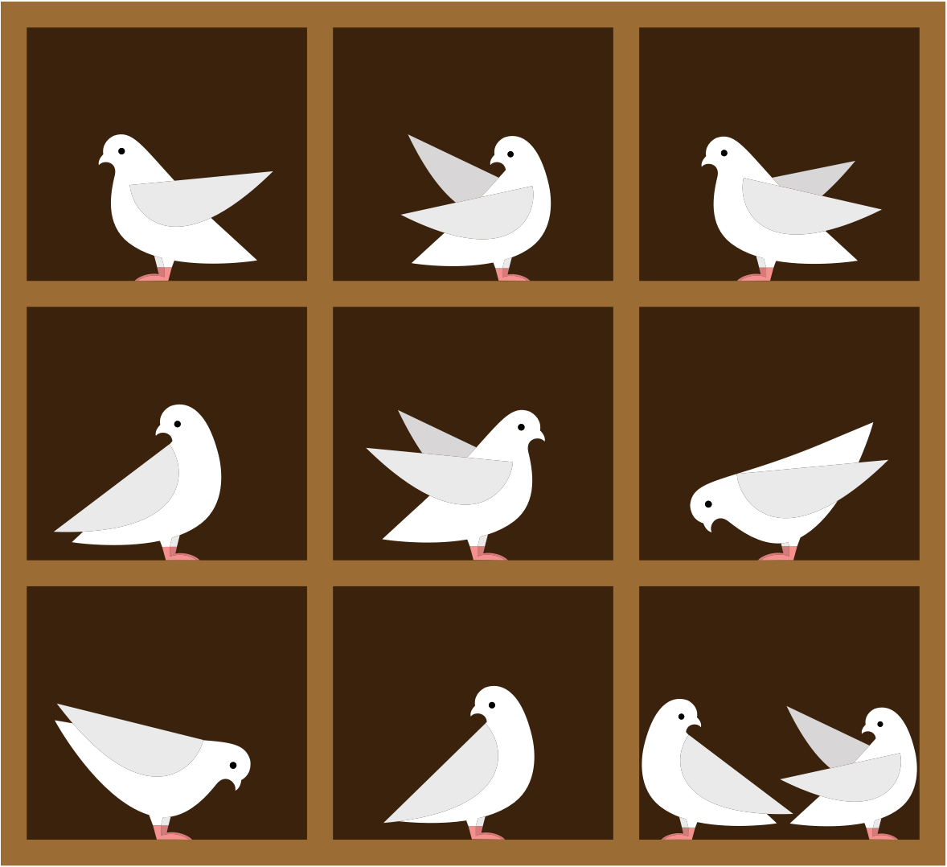
What is the Pigeonhole Principle?
Using the visual, if there are more pigeons that pigeonholes, then there is at least one pigeonhole with at least two pigeons.
The principle states that there must be at least two objects in the same box when there are more objects than boxes

Slide 3
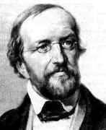
Quick History on the Principle
The pigeonhole principle is often attributed to the 19th century German mathematician Peter Gustav Lejeune Dirichlet
Dirichlet would use the principle in his work often
Because of this, the principle is also called the Dirichlet Drawer Principle
The pigeonhole principle was created by the 17th century French mathematician Jean Leurechon
Two whole centuries before Dirichlet
The principle is found in a book attributed to Leurechon

Slide 4
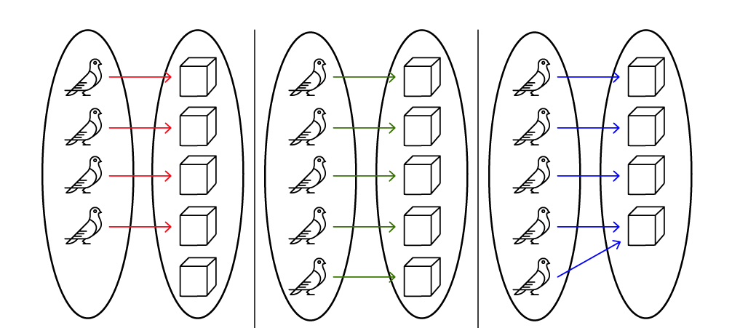
Theorem and Proof of the Pigeonhole Principle
Theorem
If k is a positive integer and k+1 objects are placed into k boxes, then there is at least one box containing two or more of the objects
Proof by contraposition
If we have k boxes that are only allowed to hold one object each, then we would have k objects
The contradiction is that we have k+1 objects

Slide 5
Lossless compression and the Pigeonhole Principle
Lossless compression
Allows data to be perfectly reconstructed from compressed data without the loss of any of the original data
It is basically impossible to have a lossless compressor that will decrease the size of every file
Depending on the file type and the data, sometimes compression won’t make much of a difference

Slide 6
A simple example
There are 8 files of bit length 3 (2³=8). We compress these files to 4 files of bit length 2 (2²=4) to have it use fewer bits of storage than the originals. At least one of the 2-bit files represents more than one of the 3-bit files.
There were 8 files but only 4 ways to represent them. Information would then be lost and it would no longer be lossless compression
File Before Compression: 000 001 010 011 100 101 110 111
File After Compression: 00 01 10 11
There were more files than there were ways to represent them, more pigeons than pigeonholes. Multiple files will be represented by 1 compressed file instead of each file being compressed and represented individually.

Slide 7
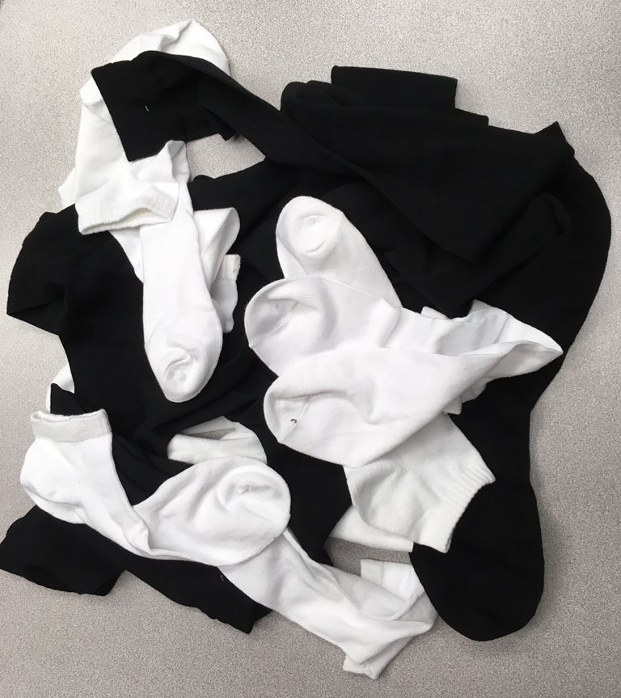
Other Examples
Having 10 white socks and 10 black socks, if you are choosing socks at random then you would at most have to choose 3 socks to have guaranteed a pair.
There are at least two people in New York City who have the same number of hairs as each other.
People can have up to half a million hairs
There are millions of people living in New York City
If more than 366 people view this presentation, at least 2 of them will have the same birthday

Slide 8
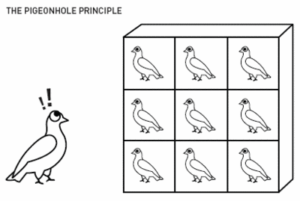
In conclusion
The pigeonhole principle is an important principle for guaranteeing the odds of a situation. As long as there are more “pigeons” than “boxes” then you will always have a box with more than one pigeon in it. I find the principle fascinating in how it can be applied to many different real life situations and how it can prove the possibility or impossibility of that situation in a simple way.

Slide 9
Sources
https://mindyourdecisions.com/blog/2008/11/25/16-fun-applications-of-the-pigeonhole-principle/#:~:text=If%20you%20have%2010%20black,by%20thinking%20sock%20by%20sock.
https://matt.might.net/articles/why-infinite-or-guaranteed-file-compression-is-impossible/
https://biblio.ugent.be/publication/4115264

